Slide 1

Medical Management System
Atharva Palande
21162121019_BDA

Slide 2


Functions in my project
1. Take new Medicine order
2. delete the latest Medicine order
3. Modify Order List
4. Print the Reciept & receipt Payment
5. Daily Summary of total Sale
6. Exit

Slide 3
Header Files
The ctype.h/<cctype> contains inbuilt functions to handle characters in C/C++ respectively.
The <cmath> contains implementation of useful mathematical functions .
The <cstdio> contains definitions for C++ for performing input and output.
The <fstream> It is used to create files, write information to files, and read information from files.

Slide 4
Header Files
The <iomanip>is part of the Input/output library of the C++ Standard Library. It defines the manipulator functions setbase() , setfill() , setprecision() , and setw() .
The define max is used to find out the largest of number passed to it.
in project its 10 .

Slide 5
Class & Constructor
A class in C++ is the building block that leads to Object-Oriented programming. It is a user-defined data type, which holds its own data members and member functions, which can be accessed and used by creating an instance of that class.
A constructor in C++ is a special 'MEMBER FUNCTION' having the same name as that of its class which is used to initialize some valid values to the data members of an object.

Slide 6
Pointer & Switch cases
A pointer is a variable that stores the memory address of an object.
The switch allows a variable to be tested for equality against a list of values. Each value is called a case, and the variable being switched on is checked for each case

Slide 7
IF Else & File Handling
An if-else statement controls conditional branching. Statements in the if-branch are executed only if the condition evaluates to a non-zero value (or true ). If the value of the condition is nonzero, the following statement gets executed, and the statement following the optional else gets skipped.
File handling in C++ is a mechanism to store the output of a program in a file and help perform various operations on it. Files help store these data permanently on a storage device. The term “Data” is commonly referred to as known facts or information.

Slide 8
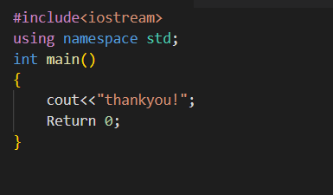
Thank you …….

